Slide 1

Chandigarh University
Department of Mathematics
B.Tech. CSE (Core/DS/IT/CC)
Semester-3
Subject Code:25MTT-202
Discrete Mathematics
Unit - 5 (Chapter- 5.3.1)
Dr. SARTAJ
DISCOVER . LEARN . EMPOWER

Slide 2

CO mappings

Slide 3

CO-PO mappings
Note: Degree of relevance/correlation: 1-Low, 2-Medium, 3-High, Blank or ‘- ‘- Nil

Slide 4
Topics Overview
Planar graph, Chromatic number
Conclusions
Video links
References

Slide 5

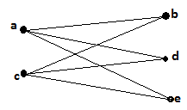


Planar Graphs
Planar graph: A graph is planar if it can be drawn in the plane without crossing edges.
Example: Here are some graphs and their planar representations.

Slide 6
Chromatic Number of a Graph
The chromatic number of a graph is the smallest number of colors needed to color the vertices of the graph such that no two adjacent vertices (having an edge between them) share the same color.
Note : 1) The chromatic number of a graph G is denoted by χ(G).
(Here χ is the Greek letter chi.)
2) If the chromatic number of a graph is n, then we say that graph is n-colorable.

Slide 7

Chromatic Number of a Graph
Some results related to Chromatic Number:
Chromatic Number of Complete Graph is the number of vertices.
Chromatic Number of Bipartite Graph with at least one edge is 2.
Chromatic Number of Cycle Graph is equal to

Slide 8
Chromatic Number of a Graph
Steps for finding the Chromatic Number:
Let the number of vertices in a graph be n.
Arrange the vertices in some order.
Choose the first vertex and color it with first color.
Choose the next vertex and color it with the lowest numbered color that hasn’t been colored on any vertex adjacent to it.
If all the adjacent vertices are colored with this color, then assign a new color.
Repeat until the coloring is done.

Slide 9
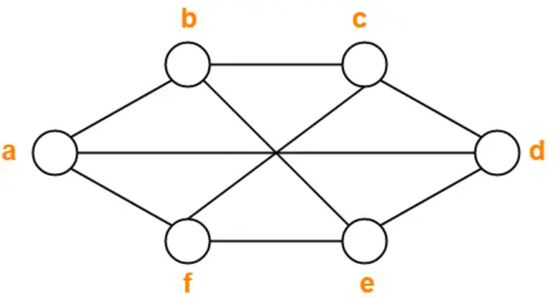
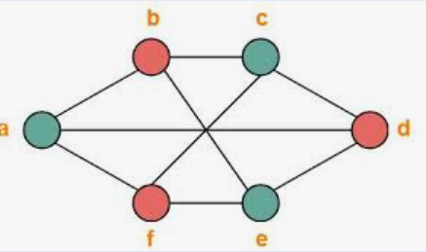
Chromatic Number of a Graph
Example: The Chromatic number of this graph is 2.

Slide 10
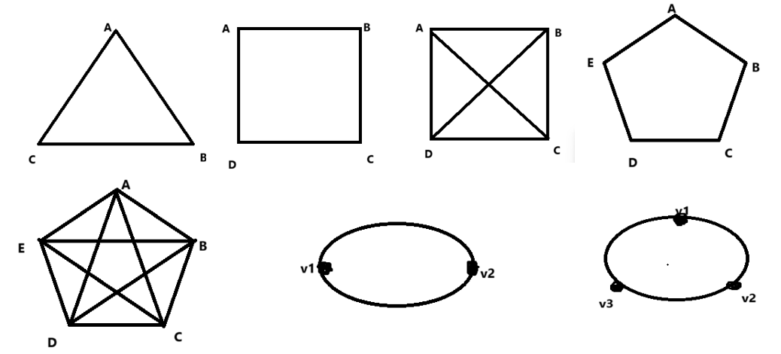
Chromatic Number of a Graph
Example: Find the Chromatic number of the following graphs:
Answer: The chromatic number of the above graphs is 3, 2, 4, 3, 5, 2, 3 respectively.

Slide 11
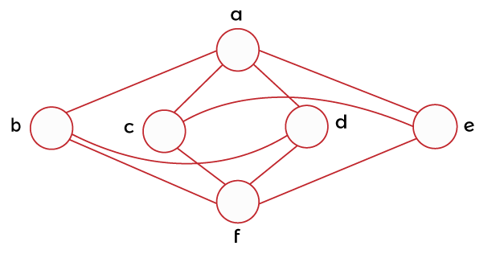
Acticity-1
Questions: Find the chromatic number of the graph.

Slide 12
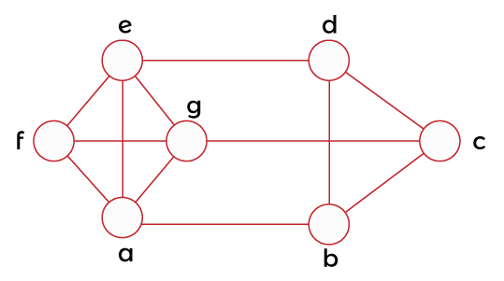
Acticity-2
Questions: Find the chromatic number of the graph.

Slide 13
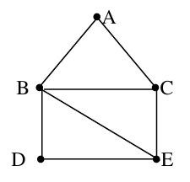
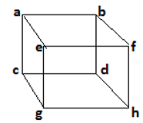
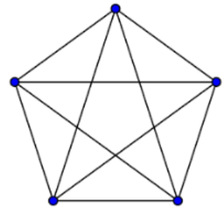
Acticity-3
Questions: Which of the following graphs is planar?

Slide 14
Conclusion
Planar graph, Chromatic number are discussed.
Related examples are given.
ns

Slide 15
Video Links
https://youtu.be/kKoIABvlmfY?si=5FyQVGkAYS8eS5uQ
https://youtu.be/ryzPoDr2KPs?si=UEUAJnV-SvVpNqlK
(Video Links)
https://drive.google.com/file/d/1zm_o2dthNGIi-OXsgP8McUz4SUlb9q3p/view?usp=sharing
(Book Link)

Slide 16
References
Sr. No. | Author | Name of the Book | Publisher | Year of Publication
1 | Kenneth H. Rosen | Discrete Mathematics and Its Applications | McGraw-Hill | 2019
2 | C. L. Liu | Elements of Discrete Mathematics | McGraw-Hill | 1996
3 | J. P. Tremblay, R. Manohar | Discrete Mathematical Structures with Applications to Computer Science | Tata McGraw Hill | 2001
4 | Kolman, Busby, Ross | Discrete Mathematical Structures | PHI | 2001
5 | Narsingh Deo | Graph Theory with Applications to Engineering and | PHI | 2017

Slide 17
Thanks!!!

